Slide 1
AI-Driven Synthetic Data Generation
in collaboration with XXX
Darya Bomberger, Kacper Krylowicz, Lucas Vilanova, Nicolas Bidaux
Capstone Project – 18.02.2022

Slide 2




Who we are …
Darya Bomberger
Kacper Krylowicz
Lucas Vilanova
Nicolas Bidaux
MBA, M.Eng
BSc Student
PhD in Mathematics
MBA

Slide 3

Data Science Bootcamp at SIT: what did we learn?
Statistics & Experimental Design: Exploring, interpreting the data
Visualization: Graphing the data with Plotly, Streamlit
Machine Learning: Supervised & unsupervised learning
Deep Learning: Neural networks with TensorFlow & Keras
Natural Language Processing (NLP)
Machine Learning Engineering: Bringing the models into production
Capstone Project: Generating synthetic tabular data
Notes:
Group challenges, hands-on practical experience.

Slide 4


Available anonymized data with real-value, would boost the success of many data science projects
We help XXX to explore new solutions and ensure compliance with…
… regulatory requirements while still be able to extract insights from data
Problem Statement
XXX operates infrastructure for the Swiss financial center related to securities, financial information & payment transactions
How to anonymize i.e. synthetize data while keeping its properties?
Strict privacy regulations govern the use and dissemination of sensitive data
Relevant analytical projects and methods explicitly depend on the availability of the data, which can be used
XXX develops and digitalizes business and private payments for the Swiss financial center.
Data science team of XXX provides internal services in the area of data analytics
Notes:
PLEASE DO NOT CHANGE PROJECT STATEMENT AS IT WAS APPROVED BY SIX
while considering the inter-variable causal relations

Slide 5
GAN
Technique

Slide 6
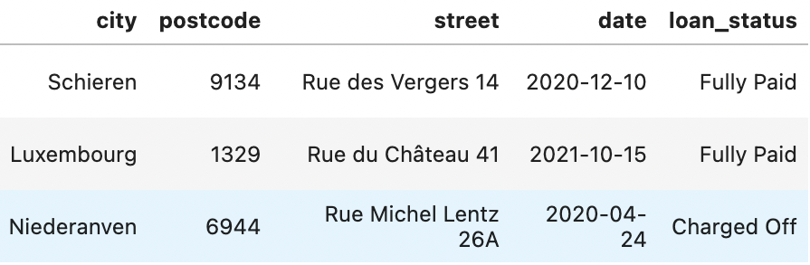
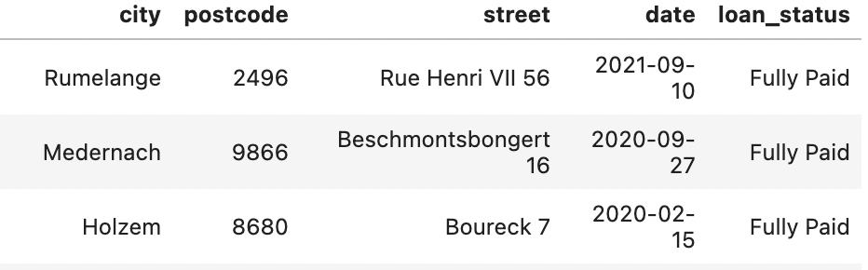

Analogically on tabular data
Clearly readable sensitive data* is transformed …
… to not allow any reference to its origin
Synthetic data is artificially generated data, commonly generated by using AI algorithms (e.g. GAN).
It is designed to mimic the real data
* Open-source data

Slide 7

Triplet-Based Variational Autoencoder (TVAE)
X
X‘
…
…
Input
Encoder
Latent
Space
Decoder
Output
Notes:
The basic scheme of a variational autoencoder. The model receives x {\displaystyle \mathbf {x} } as input. The encoder compresses it into the latent space. The decoder receives as input the information sampled from the latent space and produces x ′ {\displaystyle \mathbf {x'} } as similar as possible to x {\displaystyle \mathbf {x} } .

Slide 8





Generative Adversarial Networks (GAN)
Discriminator
Real Data
Real or fake
Generator
Fake Data

Slide 9
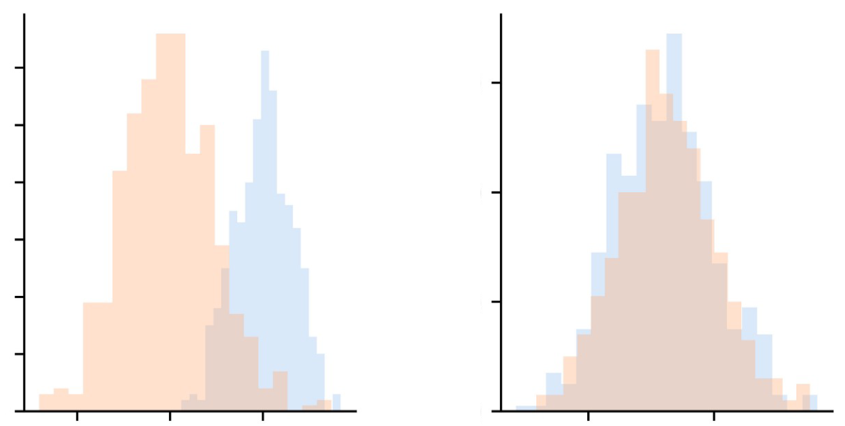

We assess our models along different dimensions
Statistical Resemblance
Model Utility
Privacy
TP
FN
Privacy
FP
TN
Do the probability distributions share similar characteristics?
What are the accuracy and other metrics when using ML models?
Is there risk to recognize or identify the real data from the synthetic data?
Privacy-preserving Deep Learning algorithms come with the inherent tradeoff between utility and privacy

Slide 10
Privacy metrics
Distance analysis
Attribute Inference Attack
Measures, via Euclidean distance, how far is the SD from RD. Returns mean and std.
Preserves privacy if:
Assumes the attacker has part of RD in addition to the STD.
Trains on STD to predict sensible data.
mean > 0.8
std < 0.3

Slide 11
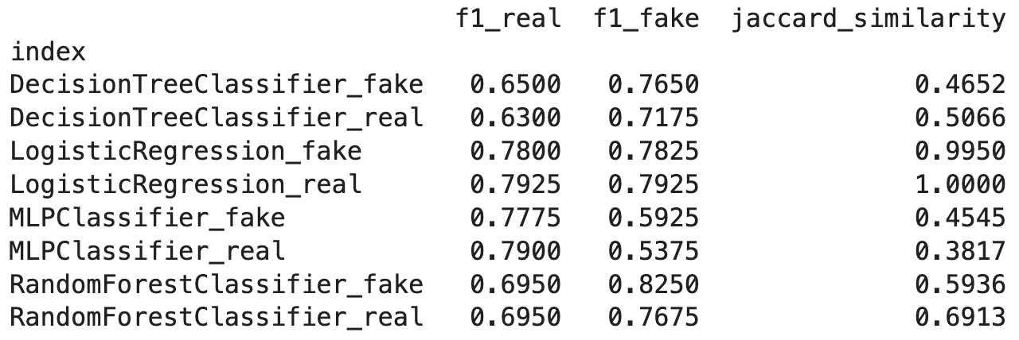
Utility metrics
Goal: Does ML models trained on STD produce similar results as ML models trained on RD?
Training RD and STD with different models. Then test on RD and STD, gather F1-scores
(or RMSE if continuous data) and compare them.
Notes:
How does the score comes? Jaccard? Jaccard Similarity = (number of observations in both sets) / (number in either set)
In utility we measure how usable is a ML model trained on the SD.

Slide 12
Resemblance metrics
Univariate analysis
Multivariate analysis
Dimensional analysis
Label identification
Does STD preserve prob. distributions?
Methods:
KS-test,
Chi-test,
means and std’s comparison
Does STD preserve correlations?
Method:
Pearson Correlation
Coefficient
Does STD preserve dimensionality?
Method:
Principal Component
Analysis
After shuffling STD and RD, can a ML model distinguish them?
Method:
As the ML model, we used Linear Regression
Notes:
Chi-squared tests to compare the independence of categorical attributes
Kolmogorov-Smirnov test is a nonparametric test that compares the cumulative distributions of two data sets. The Kolmogorov–Smirnov statistic quantifies a distance between the empirical distribution function of the sample and the cumulative distribution function of the reference distribution, or between the empirical distribution functions of two samples.
Pearson's correlation coefficient measures the strength and direction of the relationship between two variables. Coefficient values can range from +1 to -1, where +1 indicates a perfect positive relationship, -1 indicates a perfect negative relationship, and a 0 indicates no relationship exists..
Additionally, to enable the calculation of a numerical value from the visual results, a distance metric between RD and STD dimensionality reduction plots is proposed. This distance metric is the joint distance of the baricenters distance and spread distance of both plots (Equation 6). The baricenters distance is the distance between the mean values of the RD and STD dimensionality reduction matrices, while the spread distance is the distance between the standard deviation values of the same matrices

Slide 13
Identify sufficient number of entries & samples
200%
100%
Synthetic Samples (% entries)
50%
20%
100
500
1000
2000
5000
Real Samples
* see details on slide 22

Slide 14
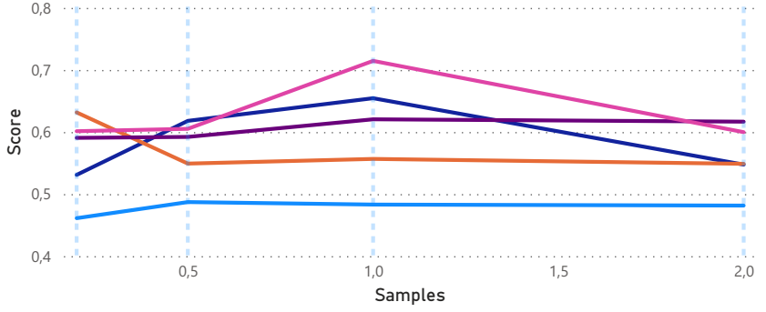
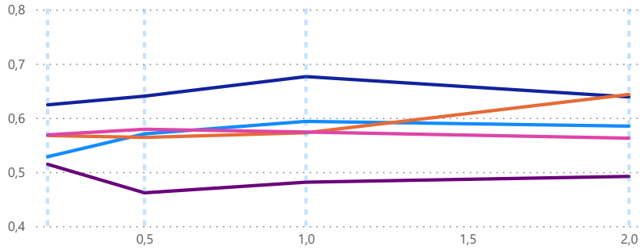
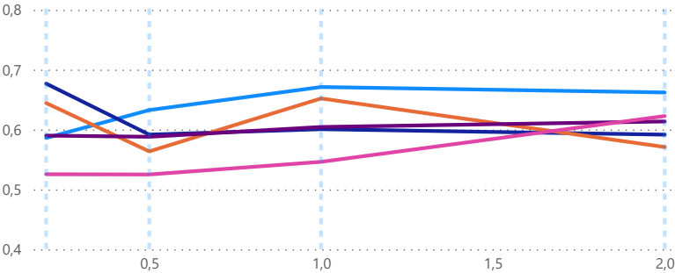
500 Epochs
More entries fewer epochs
1000 Epochs
GAN Score
1500 Epochs
Epochs
Legend
100 Entries
500 Entries
1000 Entries
2000 Entries
5000 Entries

Slide 15
The evaluation of the models reveals
Method
Model
Resemblance (R)
Utility (U)
Privacy (P)
Description
Autoencoder
TVAE
0.51
0.87
0.24
Very fast to run and generate
Good for rapid prototyping
Relatively low on both R & P
GANs
CopulaGAN
0.68
0.74
0.27
Slower to generate
Robust on data utility
Low privacy
CTGAN
0.79
0.78
0.25
Process various types of data
Wide range of the hyperparameters
Stable model performance
DP-CTGAN
0.58
0.42
0.63
Difficult to implement & run
Needs to be “built from scratch”
Highest privacy
* Trained on 5000 entries, 5000 samples, 500 epochs

Slide 16
Differential Privacy on GANs
Add noise on gradients
Discriminator
Noisy
Back- Propagation
Real Data
Real or fake
Back- Propagation
Z
Random Noise
Generator
Fake Data

Slide 17

SDV models + metrics
opacus
our package

Slide 18
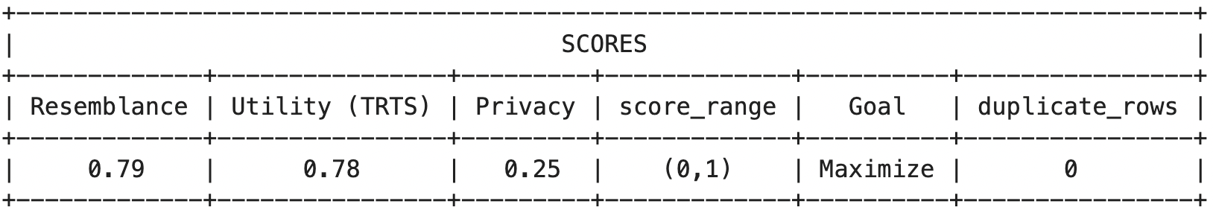
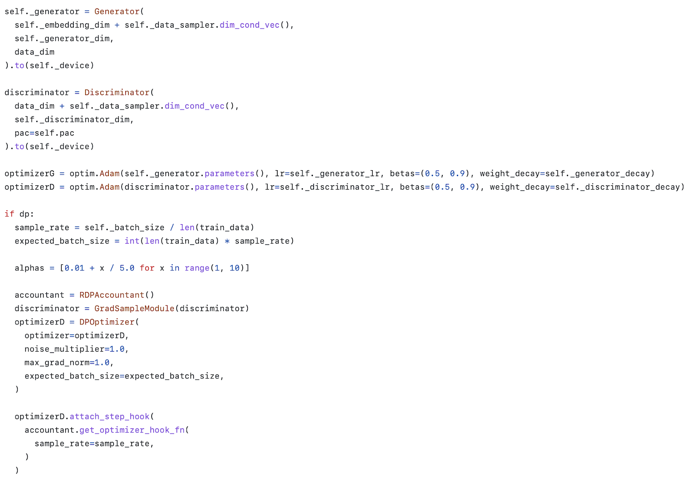
DP Extension
Table_evaluator resemblance score lacks form prob. Distr. tests and labeling identification, while sdv lacks
form multivariable analysis and dimensionality analysis.
Utility scores are better and easier calculated
with table_evaluator than in sdv.
table_evaluator and sdv have different metrics for privacy, they complement each other.

Slide 19
Synthetic data in a nutshell
Numbers of samples of real data influences the number of number of iterations(epochs) required
Quality of synthetic data is a trade-off between Utility & Privacy
Integrating differential privacy progressively reduces utility to achieve better privacy
constraints.

Slide 20
Limitations
Having real dataset would enable fine-tuning
Limited research on implementation of differential privacy for GANs
Broad research on GANs for image processing, scarce - for tabular data
Usage of different metrics make research results not comparable
Training requires high computational capacity
DP-CTGAN requires further fine-tuning

Slide 21

Thank you for your attention!

Slide 22
Overall evaluation, detailed
Entries / Generated samples (%) | 20% | 50% | 100% | 200% | Number of epochs
100 | 0.461 | 0.487 | 0.483 | 0.482 | 500
500 | 0.591 | 0.592 | 0.621 | 0.617 | 500
1000 | 0.531 | 0.618 | 0.655 | 0.548 | 500
2000 | 0.632 | 0.549 | 0.557 | 0.549 | 500
5000 | 0.601 | 0.605 | 0.715 | 0.600 | 500
100 | 0.528 | 0.571 | 0.594 | 0.585 | 1000
500 | 0.514 | 0.462 | 0.481 | 0.492 | 1000
1000 | 0.624 | 0.640 | 0.676 | 0.639 | 1000
2000 | 0.567 | 0.564 | 0.573 | 0.643 | 1000
5000 | 0.569 | 0.579 | 0.574 | 0.563 | 1000
100 | 0.586 | 0.633 | 0.671 | 0.662 | 1500
500 | 0.590 | 0.588 | 0.604 | 0.614 | 1500
1000 | 0.677 | 0.592 | 0.601 | 0.592 | 1500
2000 | 0.644 | 0.564 | 0.652 | 0.571 | 1500
5000 | 0.525 | 0.525 | 0.546 | 0.623 | 1500

